Slide 1

Analyzing Socio Economic Development Using Deep Learning on Satellite Imagery
DATA 298B
Ahaz Bhatti
Deep Arvind Bambharoliya
Shrey Bishnoi
Syama Ravi Teja Jerrypothula

Slide 2
Introduction
In the context of poverty prediction from satellite images, deep learning has emerged as a powerful approach due to its ability to learn complex and abstract features from raw pixel data, as well as its flexibility and scalability.
It is also important to optimize its hyperparameters and architecture, such as the number and size of layers, the activation functions, the optimizer, the regularization methods, and the learning rate.
Model selection is an iterative and ongoing process that requires continuous evaluation and improvement, as well as comparison with other models and baselines. This can be done through various metrics such as accuracy, precision, recall, F1-score, ROC curve, AUC, and cross-validation.
Notes:
Model selection is a crucial step in any machine learning project, including those that involve satellite images and poverty prediction.
The goal of model selection is to choose the best algorithm or architecture for a given task and dataset, based on various criteria such as performance, complexity, interpretability, and feasibility.
In the context of poverty prediction from satellite images, deep learning has emerged as a powerful approach due to its ability to learn complex and abstract features from raw pixel data, as well as its flexibility and scalability.
However, not all deep learning models are suitable for poverty prediction, and several factors must be taken into account when selecting a model, such as the size and quality of the dataset, the nature and variability of the poverty indicator, the computational resources and constraints, and the interpretability and explainability requirements.
In addition to selecting a specific type of model, it is also important to optimize its hyperparameters and architecture, such as the number and size of layers, the activation functions, the optimizer, the regularization methods, and the learning rate. This can be done through various techniques such as grid search, random search, Bayesian optimization, and neural architecture search.
Finally, model selection is an iterative and ongoing process that requires continuous evaluation and improvement, as well as comparison with other models and baselines. This can be done through various metrics such as accuracy, precision, recall, F1-score, ROC curve, AUC, and cross-validation.

Slide 3
Need for Model Selection
Model selection is a crucial step in the machine learning process, as it determines the quality and accuracy of the final model.
A good model can make accurate predictions, while a poor model can result in incorrect predictions and unreliable results such as overfitting or underfitting
Choosing the right model requires careful consideration of the data, the problem domain, and the desired outcome.
Model selection involves choosing the appropriate algorithm, tuning hyperparameters, and evaluating model performance using appropriate metrics.
Notes:
Selecting the wrong model can result in overfitting, underfitting, or poor generalization to new data.
Model selection is a tradeoff between model complexity and model performance. A simpler model may be more interpretable but less accurate, while a more complex model may be more accurate but harder to interpret.

Slide 4
Types of Model for Image Data
Convolutional Neural Networks (CNNs):
It recognize patterns in images using filters which detect features such as edges, textures and shapes.
Widely used in object detection, image classification and face detection.
Transfer Learning:
Involves pre-trained models as a starting point for training new models.as recognize a wide range of features that can be used for a variety of tasks.
It helps to reduce the amount of training data required for a new model and can improve the accuracy of the model.
Ensemble Methods:
It involves combining multiple models to improve the accuracy of the overall system.
it can be done by training multiple models with different architectures or training data and then combining their predictions.
Notes:
Convolutional Neural Networks (CNNs): These are the most commonly used deep learning models for image classification tasks. They are designed to recognize patterns in images through the use of filters that can detect features such as edges, textures, and shapes. CNNs are widely used in computer vision applications such as object recognition, image segmentation, and face detection.
Transfer Learning: Transfer learning is a technique that involves using pre-trained models as a starting point for training new models. This can be particularly useful for image classification tasks, as pre-trained models can often recognize a wide range of features that can be used for a variety of tasks. Transfer learning can help to reduce the amount of training data required for a new model and can improve the accuracy of the model.
Ensemble Methods: Ensemble methods involve combining multiple models to improve the accuracy of the overall system. This can be done by training multiple models with different architectures or training data and then combining their predictions. Ensemble methods can be particularly useful for image classification tasks where there may be multiple possible interpretations of an image.
Recurrent Neural Networks (RNNs): RNNs are another type of deep learning model that can be used for image classification. They are particularly useful for tasks that require the analysis of sequential data, such as time series or natural language processing. In image classification, RNNs can be used to analyze image sequences, such as videos or image sequences from medical imaging.
Generative Adversarial Networks (GANs): GANs are a type of deep learning model that can be used for image generation and manipulation. They consist of two neural networks: a generator that creates images and a discriminator that evaluates whether the generated images are real or fake. GANs can be used to generate synthetic images that can be used to augment training datasets or to create realistic images for use in virtual reality or gaming applications.

Slide 5
Factors to consider in model selection
Dataset size: The size of the dataset can impact the choice of model, with smaller datasets potentially benefiting from simpler models to avoid overfitting.
Model complexity: A more complex model may be able to capture more intricate patterns in the data, but can also be prone to overfitting and require more computational resources.
Training time: Training time can be a significant factor in model selection, particularly for larger datasets or models with many parameters.
Performance metrics: The choice of performance metrics can impact model selection, with some models performing better on certain metrics than others.
Interpretability: Some models are more interpretable than others, which can be important for understanding the underlying factors driving the predictions.
Notes:
Dataset size: The size of the dataset can impact the choice of model, with smaller datasets potentially benefiting from simpler models to avoid overfitting.
Model complexity: A more complex model may be able to capture more intricate patterns in the data, but can also be prone to overfitting and require more computational resources.
Training time: Training time can be a significant factor in model selection, particularly for larger datasets or models with many parameters.
Performance metrics: The choice of performance metrics can impact model selection, with some models performing better on certain metrics than others.
Interpretability: Some models are more interpretable than others, which can be important for understanding the underlying factors driving the predictions.
Transfer learning: Pretrained models that have already been trained on large image datasets can be a good option, particularly for smaller datasets, as they can be fine-tuned for the specific task at hand.

Slide 6
Proposed Models
VGG16:
VGG16 is known for its simplicity and high accuracy.
It has 16 convolutional layers and achieves good performance on a wide range of image classification tasks.
ResNet:
It’s a deep learning architecture that skip connections between layers to help address the problem of vanishing gradients.
This architecture has been shown to achieve state-of-the-art results on many image classification benchmarks.
Inception Net: Also known as "GoogLeNet,"
This model introduces the concept of inception modules where multiple filters of different sizes are used parallely to extract features.
Achieve good performance while being more computationally efficient than some other deep learning models.
DenseNet:
Deep learning architecture that connects each layer to every other layer in a feed-forward fashion.
Results in a very dense network where each layer receives direct feedback from multiple layers in the network.
Notes:
VGG16: A popular model for image classification, VGG16 is known for its simplicity and high accuracy. It consists of 16 convolutional layers and achieves good performance on a wide range of image classification tasks.
ResNet: ResNet (short for "residual network") is a deep learning architecture that introduced skip connections between layers to help address the problem of vanishing gradients. This architecture has been shown to achieve state-of-the-art results on many image classification benchmarks.
Inception Net: Also known as "GoogLeNet," Inception Net is a deep learning architecture that introduced the concept of "inception modules," which use multiple filters of different sizes in parallel to extract features from the input image. This architecture has been shown to achieve good performance while being more computationally efficient than some other deep learning models.
DenseNet: DenseNet is a deep learning architecture that connects each layer to every other layer in a feed-forward fashion. This results in a very dense network where each layer receives direct feedback from multiple layers in the network. This architecture has been shown to achieve state-of-the-art results on many image classification tasks while being computationally efficient.

Slide 7
Innovation in Model
The SE module is a neural network architecture component that enhances the representational power of convolutional neural networks (CNNs) by selectively weighting feature maps.
The SE module is composed of two key operations: squeezing and exciting. The squeezing operation is used to reduce the dimensionality of the input feature maps, while the exciting operation is used to selectively amplify important feature maps.
The SE module works by learning a set of weights that indicate the importance of each feature map in a given layer. These weights are learned through a global pooling operation followed by a series of fully connected layers.
The SE module has been shown to improve the accuracy of a wide range of CNN models on various image recognition tasks, including object detection, image classification, and semantic segmentation.
The SE module can be easily integrated into existing CNN architectures, such as VGG, ResNet, Inception, and DenseNet, by inserting it into each convolutional block.
Notes:
The SE module is a neural network architecture component that enhances the representational power of convolutional neural networks (CNNs) by selectively weighting feature maps.
The SE module is composed of two key operations: squeezing and exciting. The squeezing operation is used to reduce the dimensionality of the input feature maps, while the exciting operation is used to selectively amplify important feature maps.
The SE module works by learning a set of weights that indicate the importance of each feature map in a given layer. These weights are learned through a global pooling operation followed by a series of fully connected layers.
The SE module has been shown to improve the accuracy of a wide range of CNN models on various image recognition tasks, including object detection, image classification, and semantic segmentation.
The SE module can be easily integrated into existing CNN architectures, such as VGG, ResNet, Inception, and DenseNet, by inserting it into each convolutional block.
The SE module has been found to be particularly effective in scenarios where the input data is noisy or has a high degree of variability, such as in medical image analysis or remote sensing.
The SE module is typically evaluated using standard performance metrics, such as classification accuracy, precision, recall, and F1 score. Another useful metric is the R-squared (R2) score, which measures how well the SE module's predictions fit the ground truth labels.
Overall, the SE module is a powerful technique for improving the performance of CNN models, and its widespread adoption is expected to continue in the future.

Slide 8
Strengths of Each Models
VGG 16
Highly accurate
Easy to implement and train due to its simple and consistent structure.
ResNet
Alleviate the vanishing gradient problem, allowing for deeper architectures with improved accuracy.
Achieves state-of-the-art performance on many image classification tasks.
InceptionNet 121
Uses multiple filters of different sizes in parallel to extract features at multiple scales, resulting in improved accuracy
Efficient use of computation resources due to its use of factorization and pooling operations.
DenseNet
High accuracy due to its dense connectivity pattern, allowing for efficient feature reuse and improved gradient flow.
Reduces the number of parameters and computation required compared to other models with similar accuracy.
Notes:
VGG16:
Highly accurate due to its deep architecture with many convolutional layers.
Easy to implement and train due to its simple and consistent structure.
Good for transfer learning due to its popularity and availability of pre-trained weights.
ResNet:
Residual connections help alleviate the vanishing gradient problem, allowing for deeper architectures with improved accuracy.
Achieves state-of-the-art performance on many image classification tasks.
Good for transfer learning due to its popularity and availability of pre-trained weights.
InceptionNet:
Uses multiple filters of different sizes in parallel to extract features at multiple scales, resulting in improved accuracy.
Efficient use of computation resources due to its use of factorization and pooling operations.
Good for transfer learning due to its popularity and availability of pre-trained weights.
DenseNet:
High accuracy due to its dense connectivity pattern, allowing for efficient feature reuse and improved gradient flow.
Reduces the number of parameters and computation required compared to other models with similar accuracy.
Good for transfer learning due to its popularity and availability of pre-trained weights.

Slide 9
Weakness of Each Model
VGG16
It has a large number of parameters, which makes it computationally expensive to train.
The number of layers and filters can lead to overfitting if the dataset is small.
The model is deeper than some other architectures, which can make it harder to train.
ResNet
The model is very deep, which can make it harder to train.
The identity connections can lead to increased memory usage during training.
The model may not perform as well on small datasets.
DenseNet
The model has a large number of parameters, which can make it computationally expensive to train.
The dense connections can lead to increased memory usage during training.
The model may not perform as well on small datasets.
InceptionNet
The model has a large number of parameters, which can make it computationally expensive to train.
The complex architecture can make it harder to interpret what the model is learning.
The model may not perform as well on small datasets.

Slide 10
Evaluation Metrics
Accuracy
Precision
Recall
F1-score
AUC-ROC Curve
Confusion Matrix
Measures the proportion of correctly classified images among all images in the test set.
It is commonly used in image classification tasks.
Measures the proportion of true positive predictions among all positive predictions made by the model.
It is useful when we want to minimize the number of false positives.
Measures the proportion of true positive predictions among all actual positive examples in the test set
It is useful when we want to minimize the number of false negatives.
Measures the harmonic mean of precision and recall
Good metric to use when we want to balance both precision and recall.
Used to evaluate binary classification problems.
Measures the area under the receiver operating characteristic (ROC) curve.
Summarizes the performance of a classification model on a set of test data.
It shows the number of true positives, true negatives, false positives, and false negatives.
Notes:
For image classification tasks, evaluation metrics such as accuracy, precision, recall, and F1 score are commonly used.
In this project, we may also consider using the Area Under the Receiver Operating Characteristic curve (AUC-ROC) as an evaluation metric.
Another commonly used evaluation metric for regression tasks is the mean squared error (MSE).
The R-squared (R2) score is a popular evaluation metric used in regression tasks that measures the proportion of variance in the target variable that is explained by the model. A high R2 score indicates that the model is able to explain a large proportion of the variance in the target variable, while a low R2 score indicates that the model is not able to explain much of the variance. In this project, we may use the R2 score to evaluate the performance of the regression models used for predicting poverty.

Slide 11
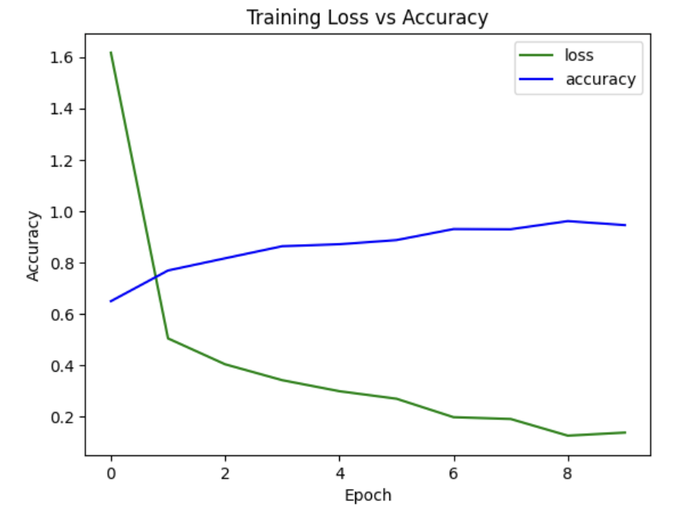
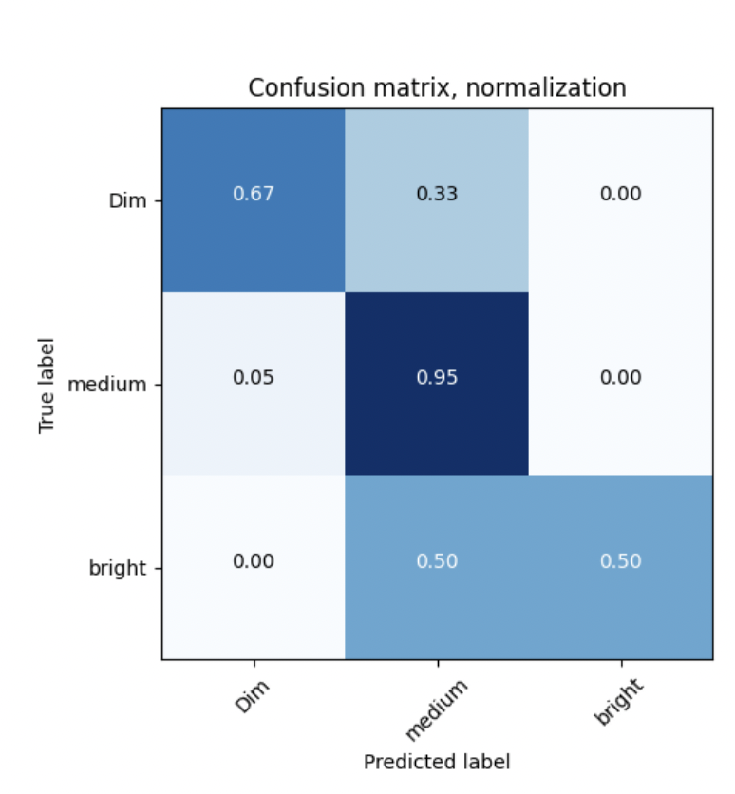
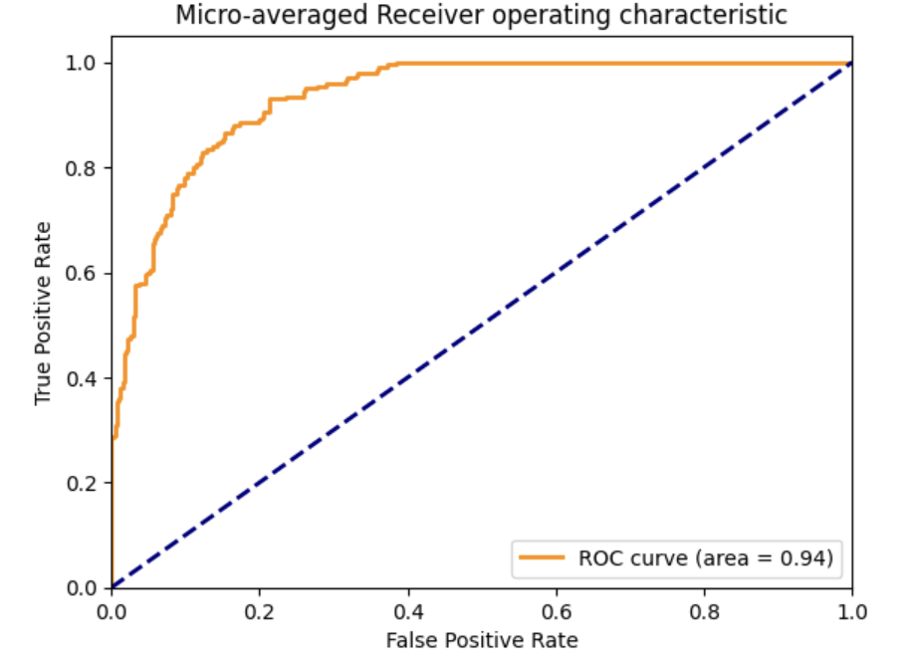
Machine Learning Evaluation Results
Resnet 50
Time taken for feature extraction of train data: 993.9159195423126 seconds
Time taken for feature extraction of test data: 105.01619172096252 seconds
Training time: 268.5920615196228s
Test loss: 0.4753
Test accuracy: 0.7900

Slide 12
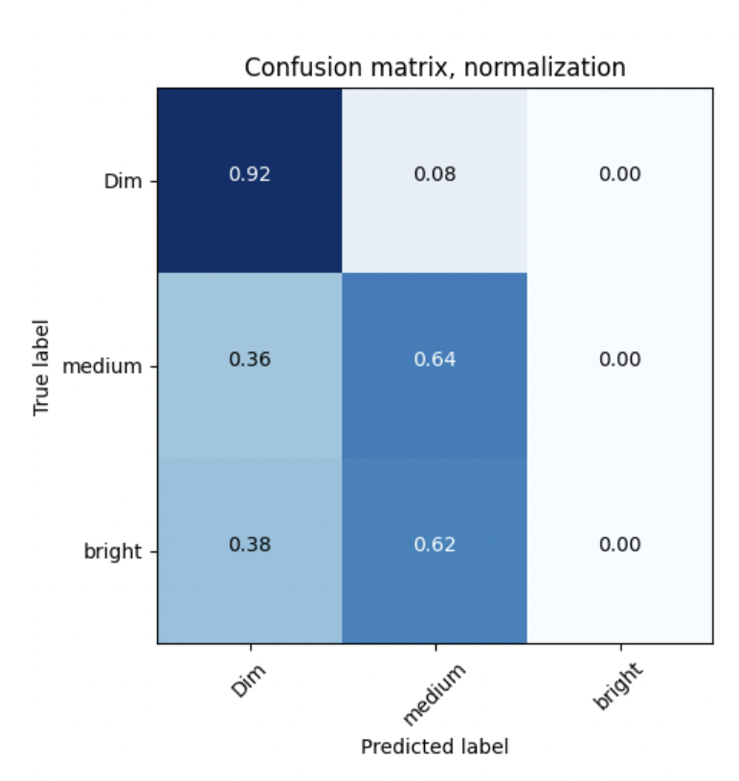
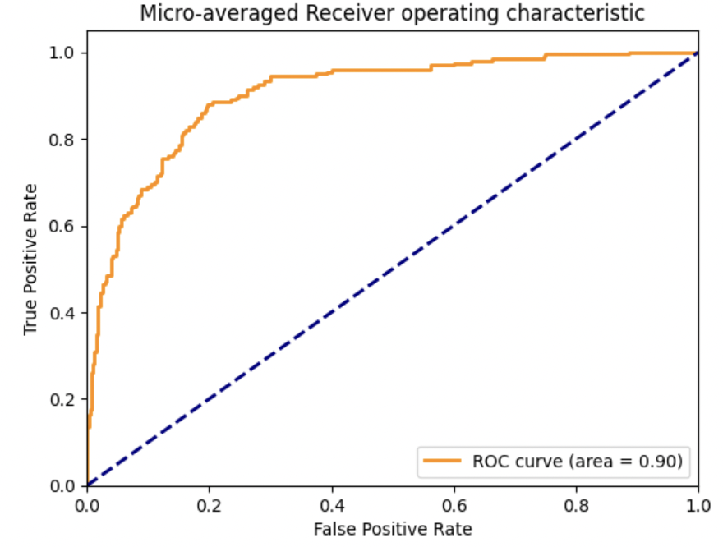
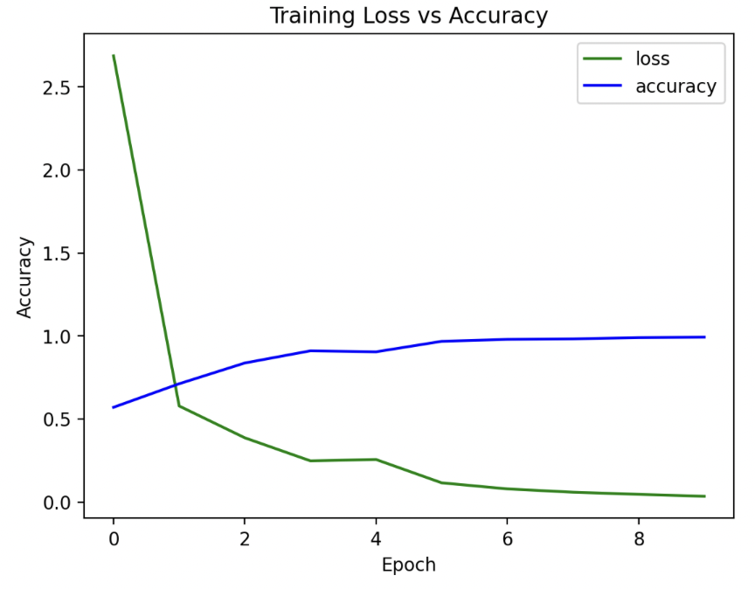
Vgg 16
Time taken for feature extraction: 757.7331955432892 seconds
Time taken for feature extraction of test data: 221.8137936592102 seconds
Training time: 83.79679918289185s
Test loss: 0.7274
Test accuracy: 0.7550

Slide 13
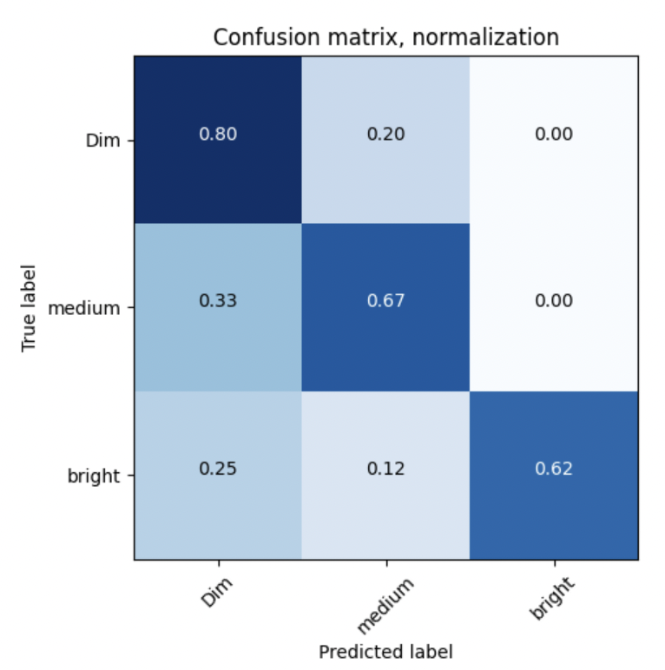
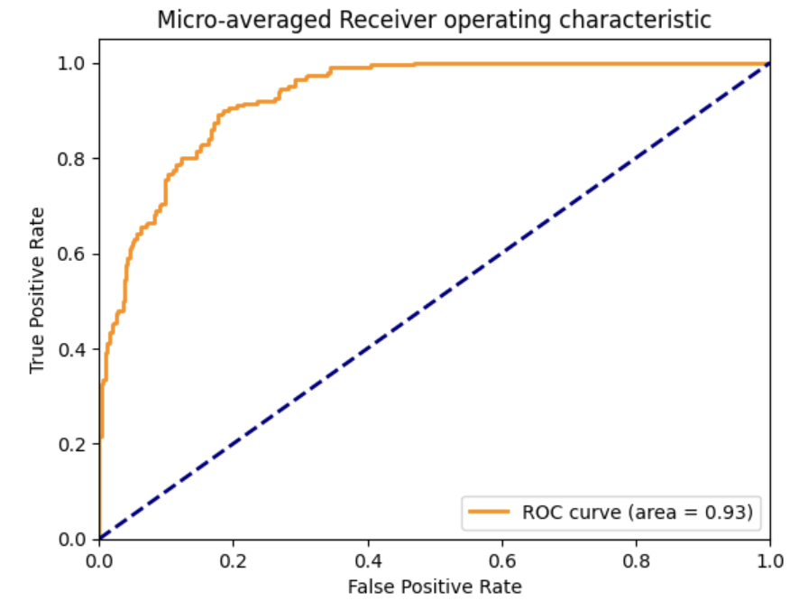
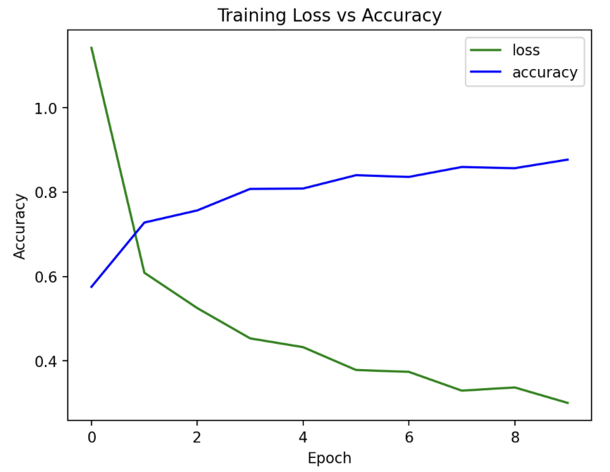
Densenet
Test loss: 0.6281
Test accuracy: 0.7150
Time taken for feature extraction of train data: 964.4140601158142 seconds
Time taken for feature extraction of test data: 137.51107263565063 seconds
Training time: 113.20215225219727s

Slide 14
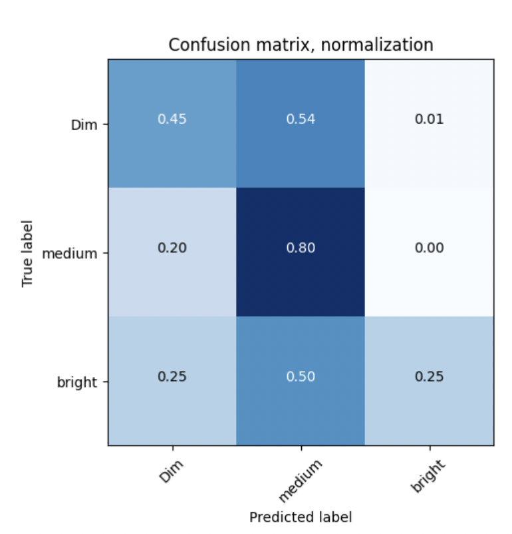
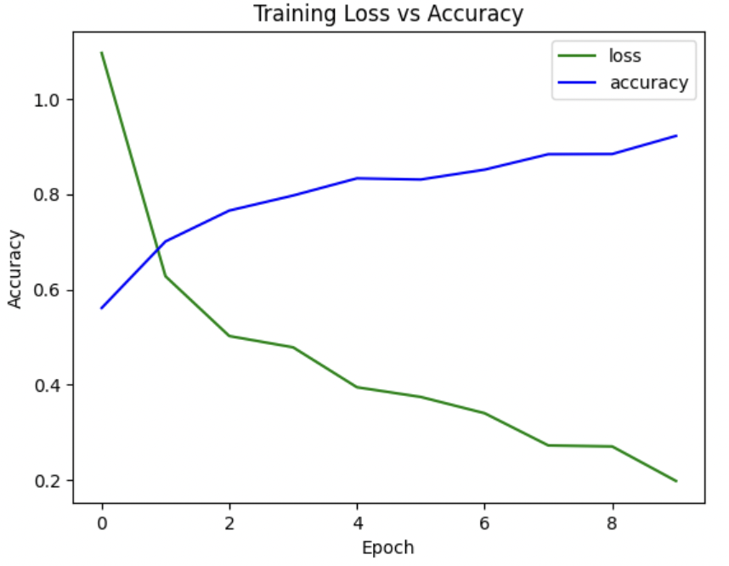
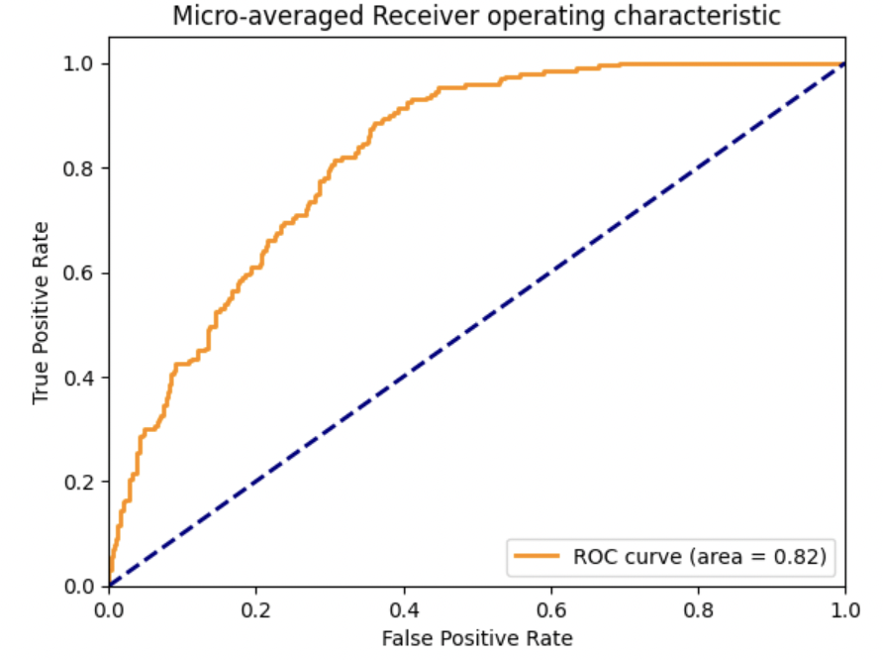
Inception Net
Time taken for feature extraction of train data: 879.3772072792053 seconds
Time taken for feature extraction of test data: 168.4284327030182 seconds
Training time: 208.14280676841736s
Test loss: 0.8463
Test accuracy: 0.6050

Slide 15
Result Comparison
Model Name | Time Taken(sec) | Accuracy
ResNet - 50 | 1366.75 | 0.79
VGG - 16 | 1063.33 | 0.75
DenseNet | 1215.12 | 0.71
InceptionNet 121 | 1255.93 | 0.60

Slide 16
Web-based system design and demo UI
Amazon Web Services (AWS)
AWS Cloud9
AWS SageMaker
AWS S3 Bucket
AWS Elastic Compute (EC2)
AWS VPC
HyperText Markup Language (HTML)
Cascading Style Sheets (CSS)
JavaScript Object Notation (JSON)

Slide 17
Our web-based UI for poverty detection aims to provide an accessible and user-friendly platform for identifying people who are at risk of poverty. By leveraging HTML and CSS, we have designed an intuitive interface that allows users to input relevant images and retrieve poverty predictions with ease. We also incorporated Jakob Nielsen's 10 usability heuristics to enhance the overall UI design.
The core of our poverty detection model is powered by Python, which allows for efficient and effective execution of the application logic. We leveraged Python Flask to build the web-based UI, which streamlined the process of creating and deploying our website. Furthermore, the use of AWS Cloud9 as our hosting platform has allowed us to easily manage and scale our application as necessary.

Slide 18

Home Page

Slide 19
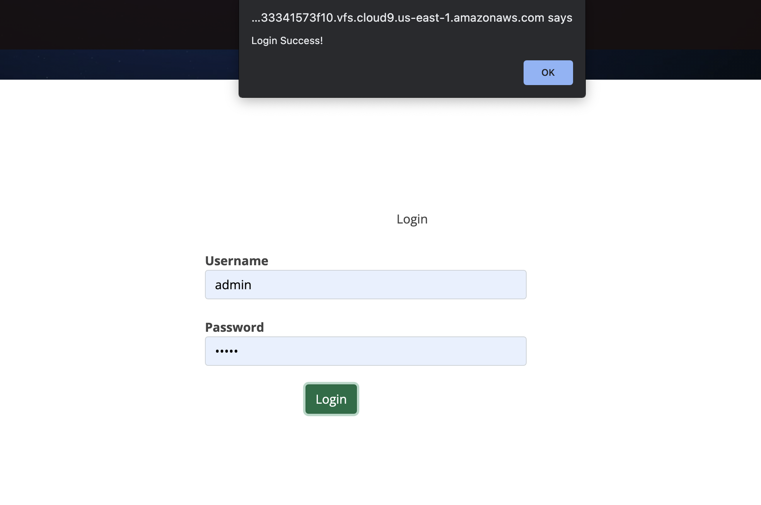
Login Page

Slide 20
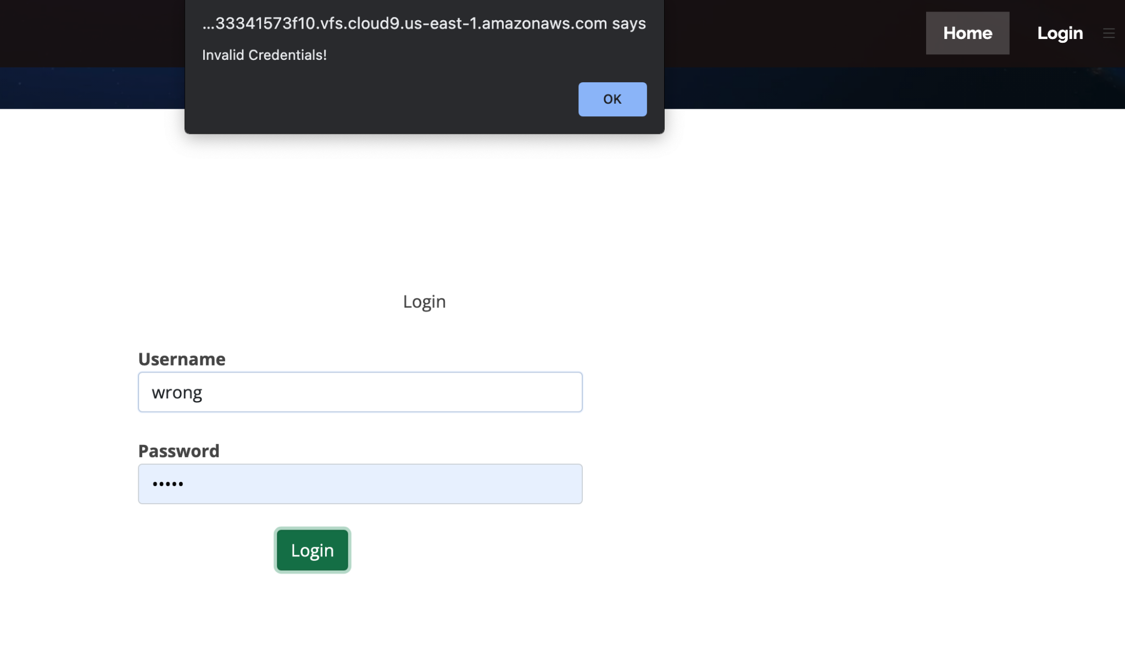
Login Invalid Credentials

Slide 21

Clustering Page

Slide 22

Clustering of the Image

Slide 23

Poverty Prediction Page

Slide 24

Wealth Prediction
Page

Slide 25
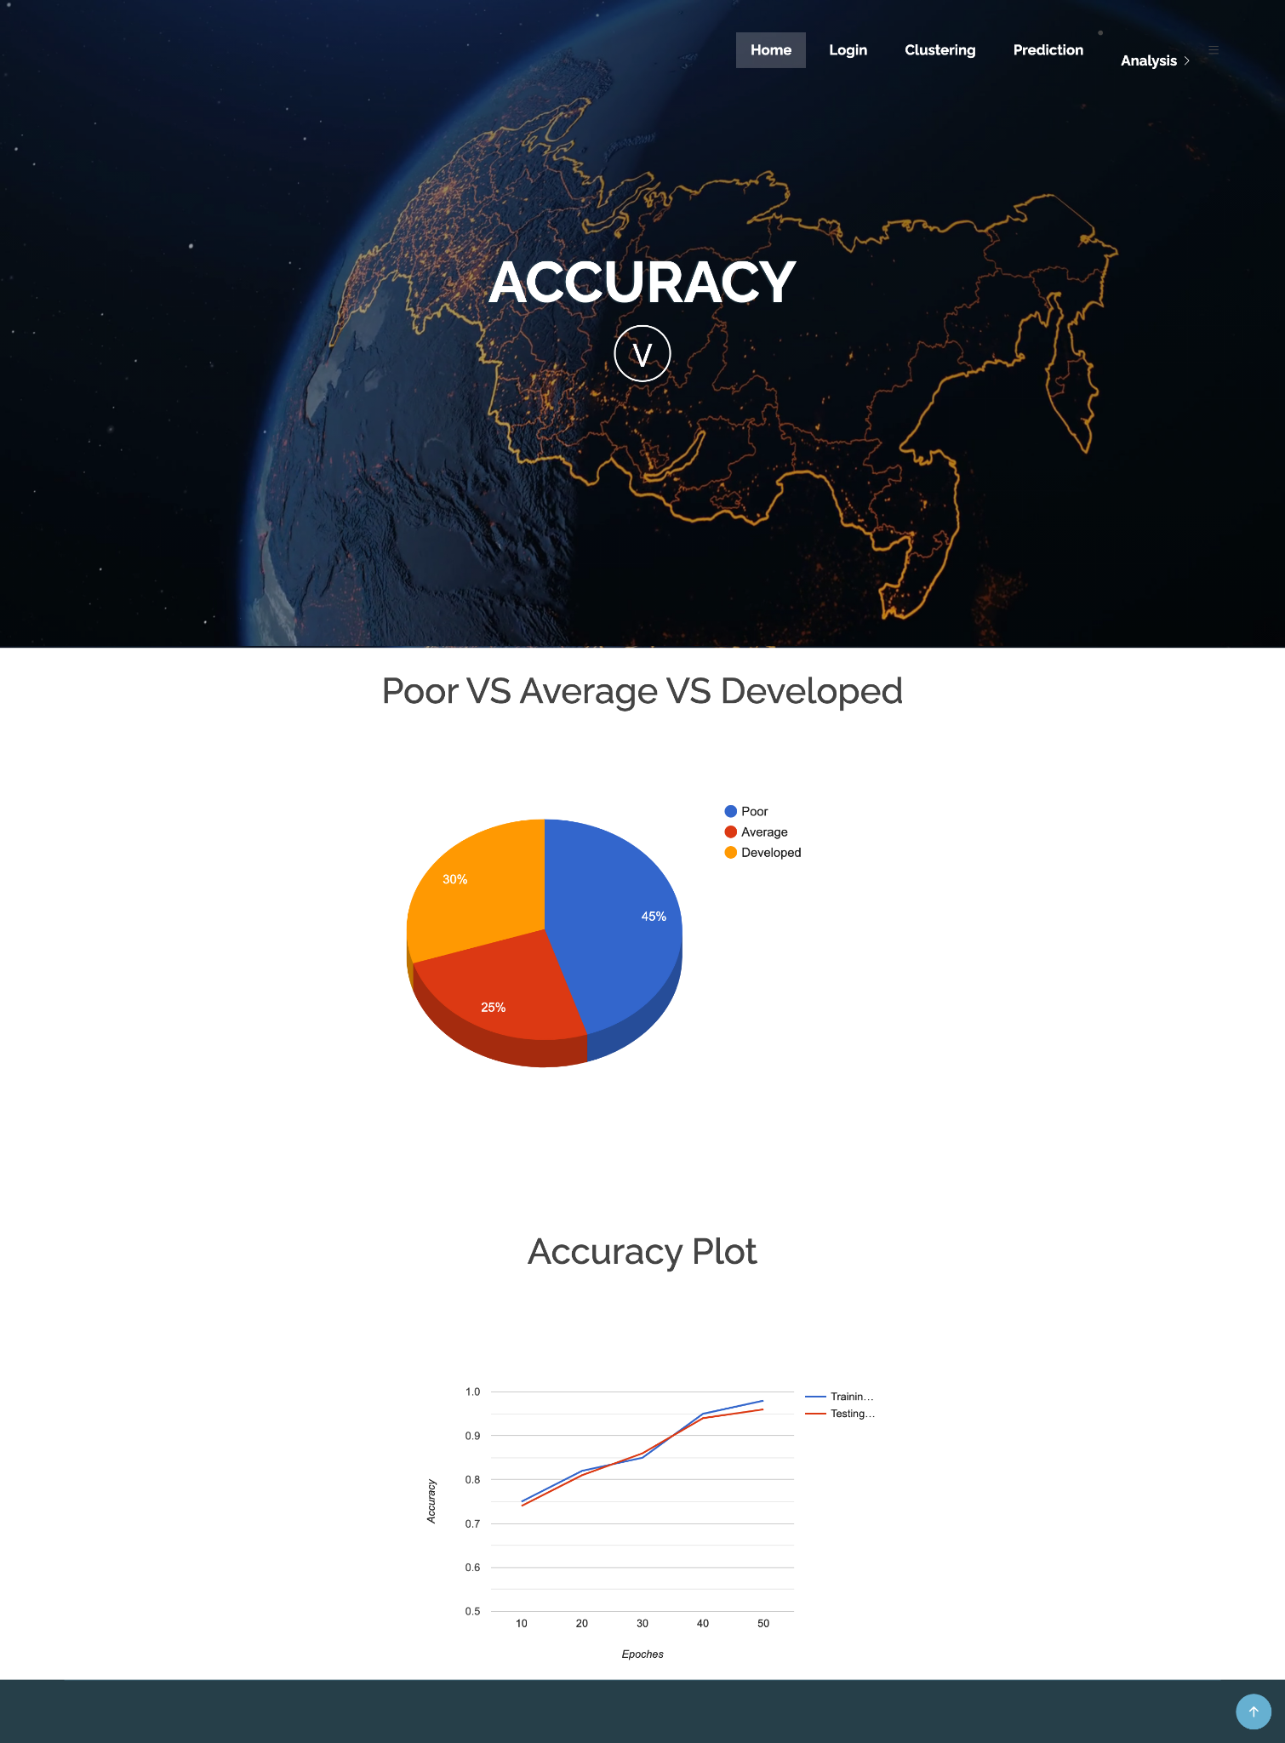
Accuracy Results Page

Slide 26

Wealth Analysis Distribution Page

Slide 27
Sample Demo

Slide 28
THANK YOU
Notes:
Thats it for today, Thank you

